Slide 1

Web technologies lab 1
Laiba binta tahir
FA21-BSE-019
​​
10/3/2023

Slide 2


HTML
HTML tells a web browser how to display text, and images on a webpage
Simply anything we see on the browser (in text or pictures form)
The tags <> are used to embed text or images.​

Slide 3
What Are HTML Tags?
Tag | Description
<body> | Defines the document's body
<h1> to <h6> | Defines HTML headings
<p> | Defines a paragraph
<br> | Inserts a single-line break
<!--...--> | Defines a comment
Tags are used to mark up the start of an HTML element and they are usually enclosed in angle brackets.
An example of a tag is: <h1>.
Most tags must be opened <h1> and closed </h1> in order to function.
Not all tags in HTML are in pairs (e-g: image tag).

Slide 4
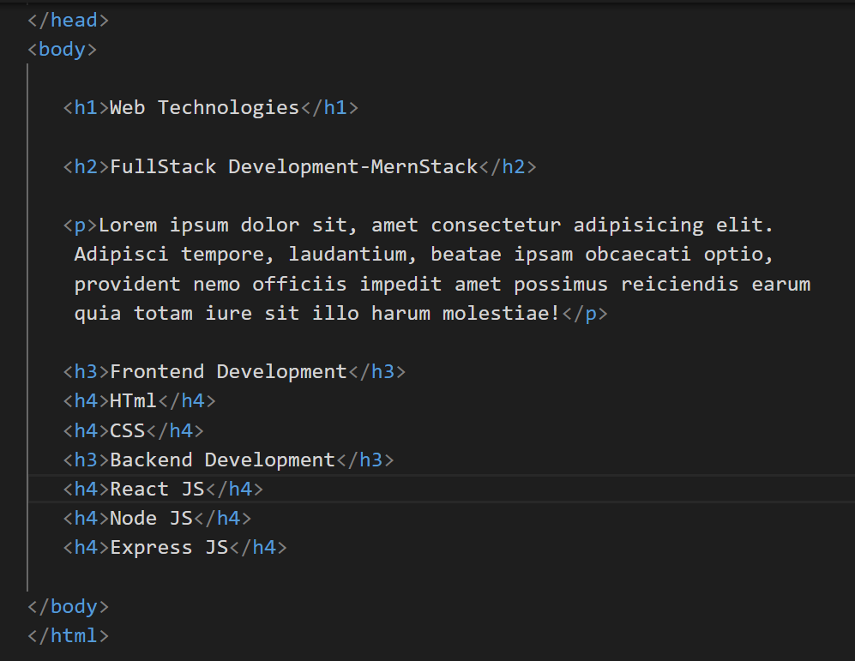
What Are HTML Tags?
HTML <p> and <h> tags
The <h1> to <h6> tags are used to define HTML headings.
The <p> tag defines a paragraph.
Browsers automatically add a single blank line before and after each <p> element.

Slide 5
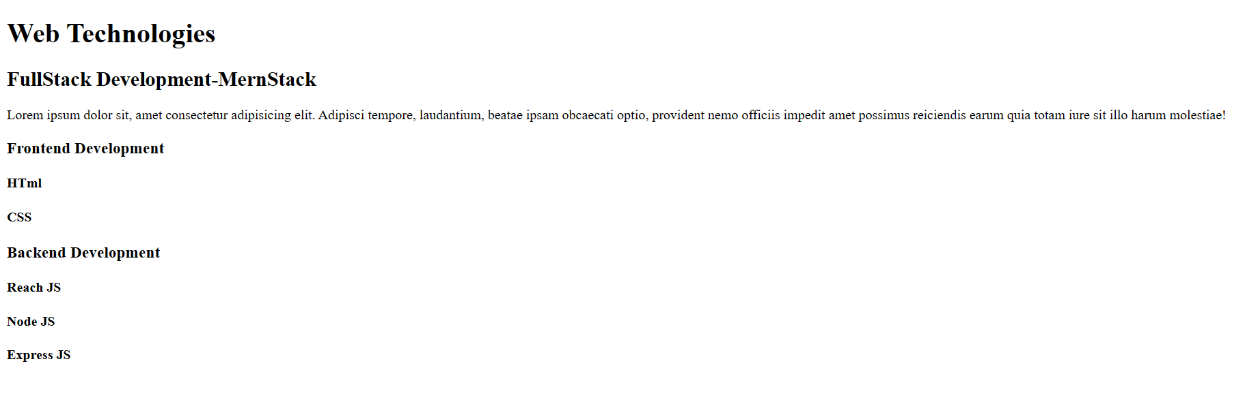
Output of <p> and <h> tags in browser

Slide 6
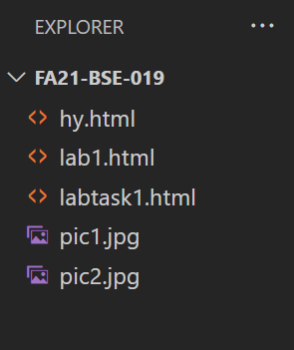
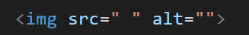
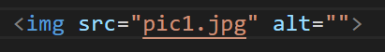
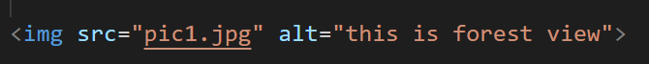
HTML <img> tag
The <img> tag is used to embed an image in an HTML page.
The <img> tag has two required attributes:
src - Specifies the path to the image
alt - Specifies an alternate text for the image, if the image for some reason cannot be displayed

Slide 7
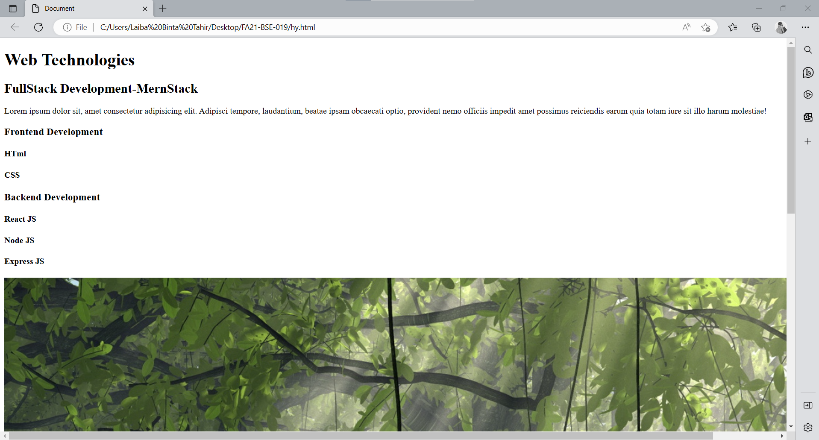
Image properties
As you see the image is quite large(i-e the actual size of the image)
In order to reduce it we have to consider image properties:
Width
Length

Slide 8
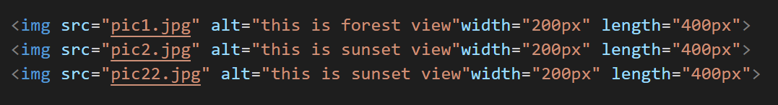

Continued…
Note: alt - Specifies an alternate text for the image, if the image for some reason cannot be displayed. See <img> tag 3 where src is somehow incorrect.
Also, see the effect of image properties
All three images are inline(we will discuss it in the next slides)

Slide 9
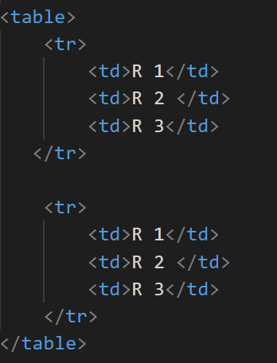
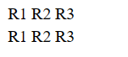
HTML <table> tag
The <table> tag defines an HTML table.
An HTML table consists of one <table> element and one or more <tr>, and <td> elements.
<tr> element defines a table row.
<td> element defines a table cell.
For example: insert a table having 2 rows and 3 columns.
output is :
in the browser, the table is displayed but without border or cells
So for that, we have to consider table properties….

Slide 10
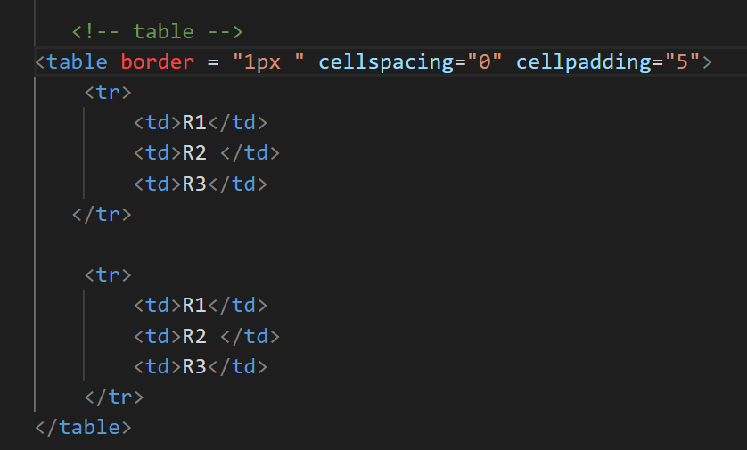
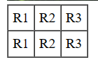
Table properties
HTML tables can be adjusted by the border, the padding inside the cells, and also the space between the cells.
Cell spacing: the space between each cell.
Cell padding: the space between the cell edges and the cell content.

Slide 11
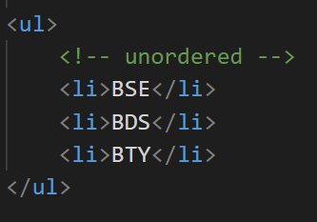
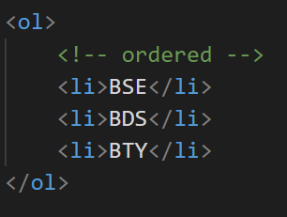
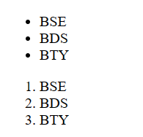
HTML List tag
The <ul> tag defines an unordered (bulleted) list.
The <ol> tag defines an ordered list. An ordered list can be numerical or alphabetical.
The <li> tag is used to define each list item.

Slide 12
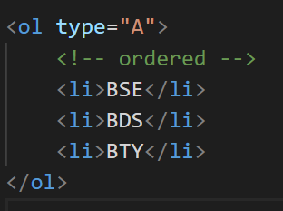
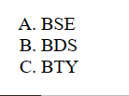
Continued…
If you want to describe the type of ordered list.
Just indicate the type in <ol> tag:

Slide 13
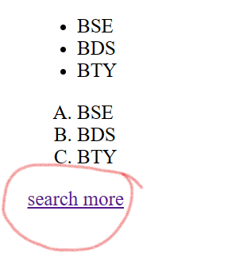
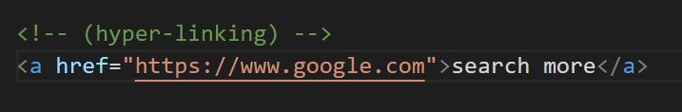
HTML Links - Hyperlinks
HTML links are hyperlinks. You can click on a link and jump to another document.
The HTML <a> tag defines a hyperlink. It has the following syntax:
<a href=“URL">link text</a>

Slide 14
HTML <form> Tag
The <form> tag is used to create an HTML form for user input. Syntax:
<form action=“ "> </form>
The <form> element can contain one or more of the following form elements:
<button>
<option>
<label>

Slide 15
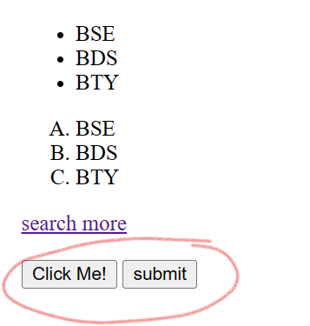
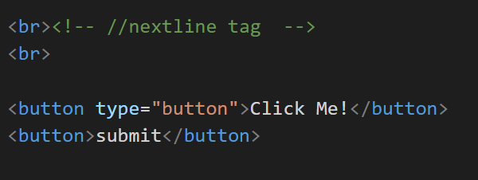
HTML <button> Tag
A clickable button is marked up as follows:
<button type="button">Click Me!</button> OR
<button>submit</button>
Both buttons are inline(we will discuss it in the next slides)

Slide 16
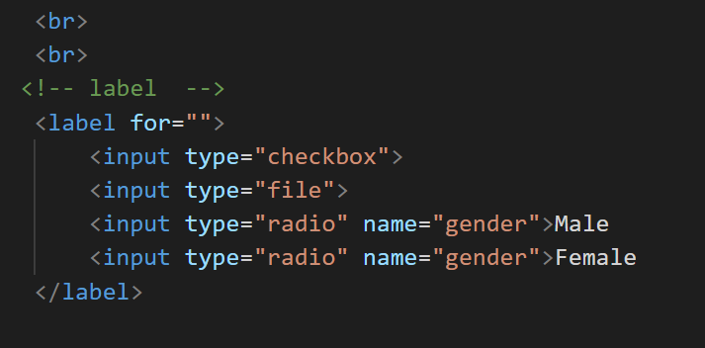
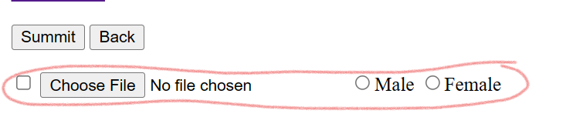
HTML <label> Tag
The <label> tag defines a label for several elements:
<input type="checkbox">
<input type="color">

Slide 17
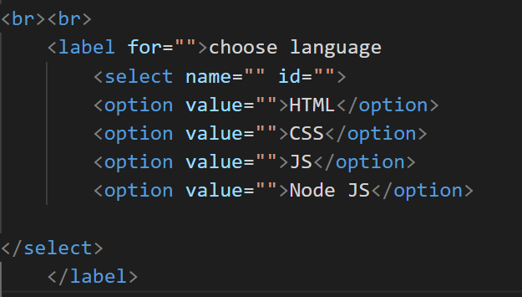
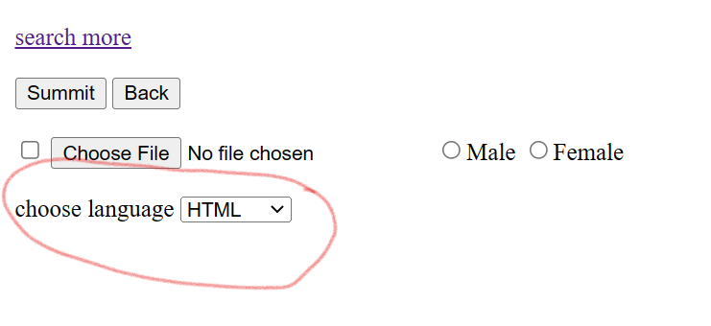
HTML <option> Tag
The <option> tag defines an option in a select list

Slide 18

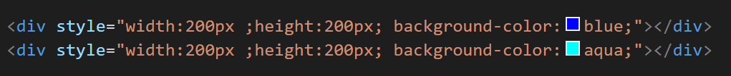
HTML <div> Tag
The <div> tag defines a division or a section in an HTML document.

Slide 19
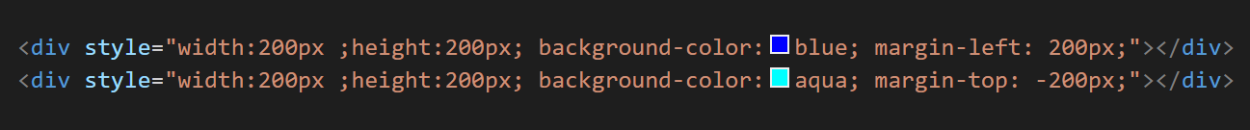
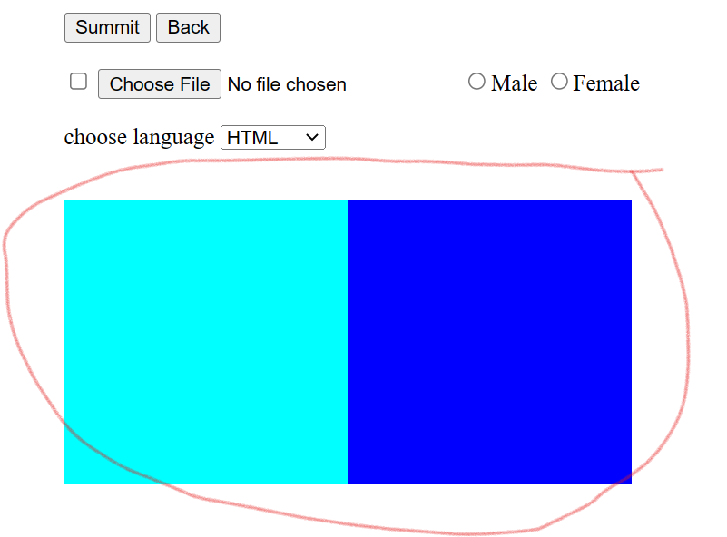
Place the div’s inline
Margins are used to create space around elements

Slide 20
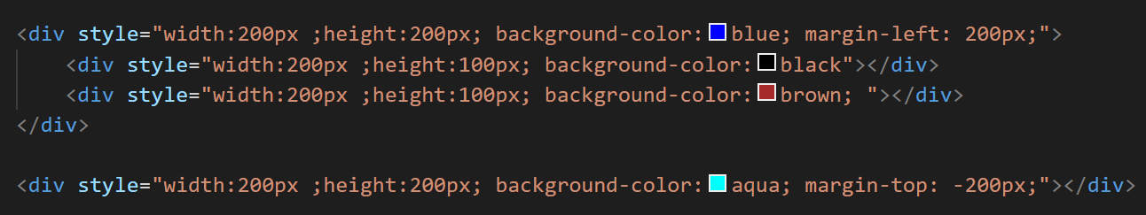

Continued…

Slide 21
HTML Elements
1. Inline elements
An inline element does not start on a new line.
An inline element only occupies as much space as necessary.
e-g: Input tags

Slide 22
2. Block-level elements
A block-level element occupies the available space when it renders.
Block-level Elements always start on a new line, and the browsers automatically add some space before and after the element.
Some block elements are: <p> <h> <ul> and <div>

Slide 23


What instructs the browser on how do you display a particular text or image?
All tags in HTML are in pairs( T/F )
Is img tag an inline element?
How many sizes of headers are available in HTML by default?
HTML files are saved by default with the extension?

Slide 24


TASKS:

Slide 25
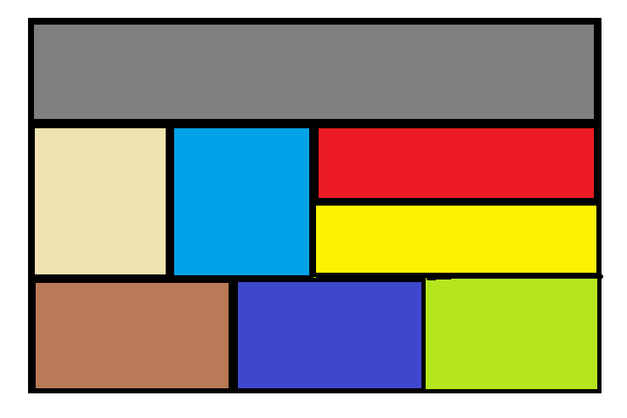
Merge any two columns and rows of the table.
Hyperlink <h1> tag
Create An Anchor Tag (link to Google)
Produce a list in Roman numbers
Implement the following:

Slide 26
Thank you
Laiba binta tahir ​​
FA21-BSE-019(4A)​
laibabintatahir@gmail.com​
​

